Slide 1
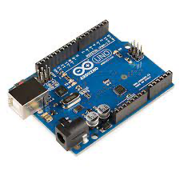
Arduino Hardware and IDE

Slide 2
What is Arduino?
An Arduino is an open-source hardware development platform used to develop easy-to-use electronic devices to interact with the real world. The hardware configuration of an Arduino is open source which means that it can be modified in order to make different versions of itself.

Slide 3
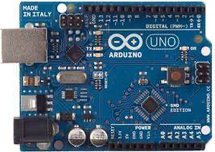
Arduino UNO
An Arduino UNO is an open-source microcontroller board which is based on Atmega328p. It is a standard board of Arduino which is easy to operate in comparison to other Arduino boards. Along with 14 digital input/output pins, six of which are analog input pins, the board also has a USB port, reset button, ICSP header, and other components. The Arduino UNO board already has these components loaded, and we can utilize them in your project. The board's USB port or its DC power supply can both be used to charge the gadget and feed/receive the data from it.

Slide 4
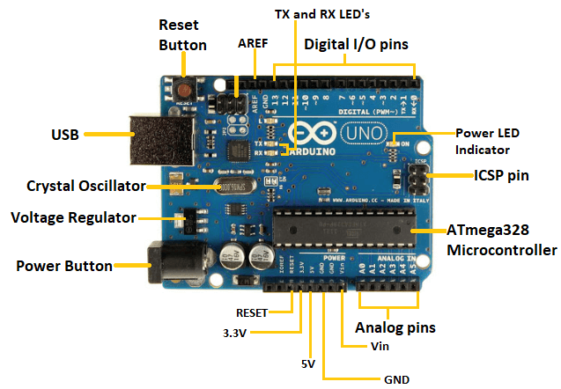
Components of Arduino UNO
1.

